Slide 1


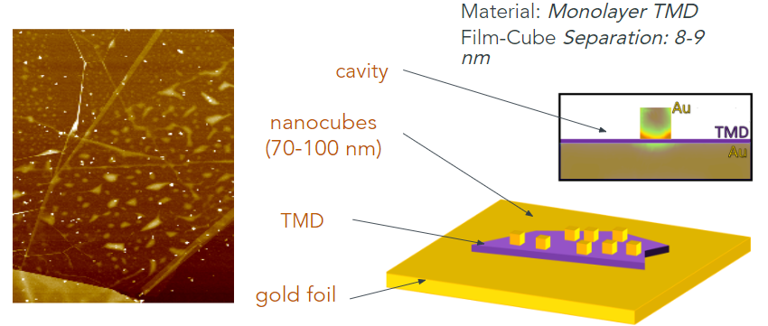
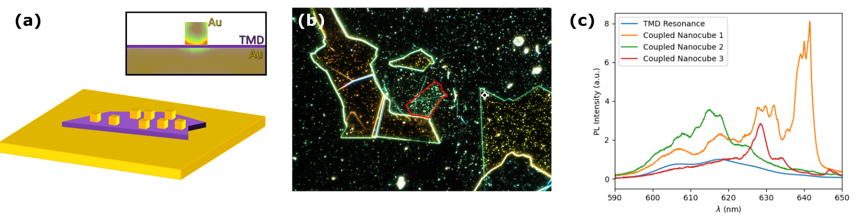
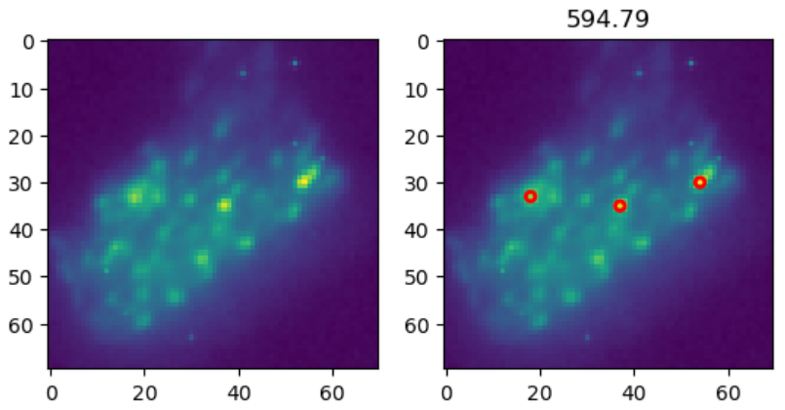
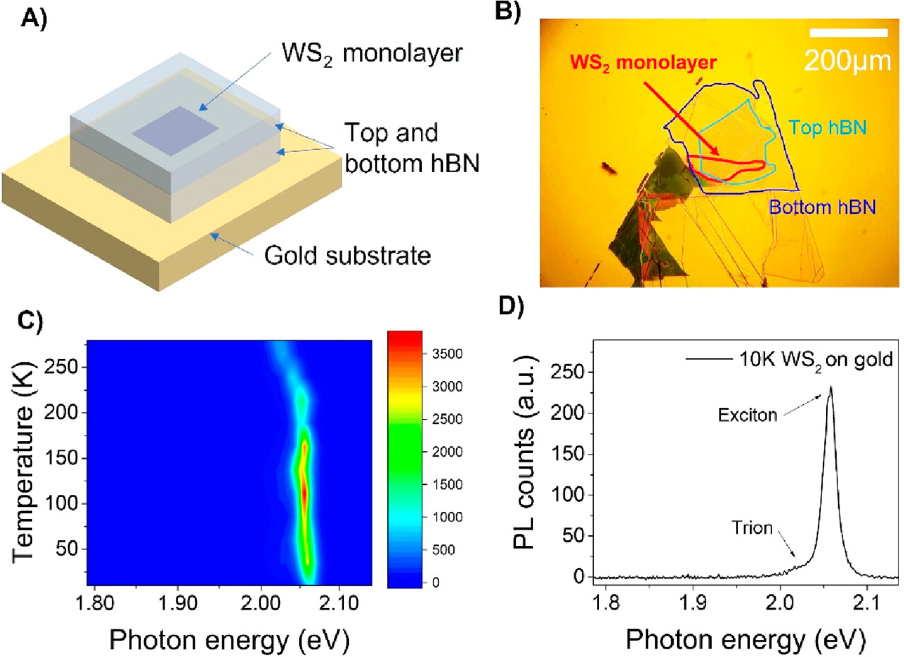
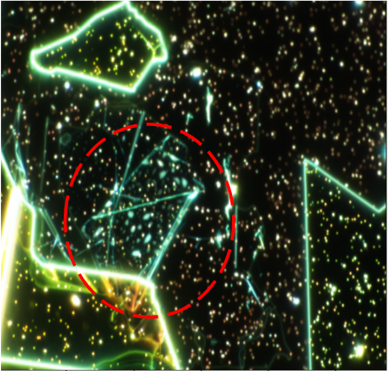
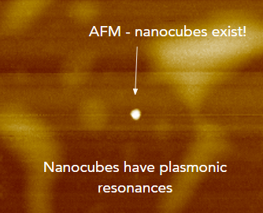

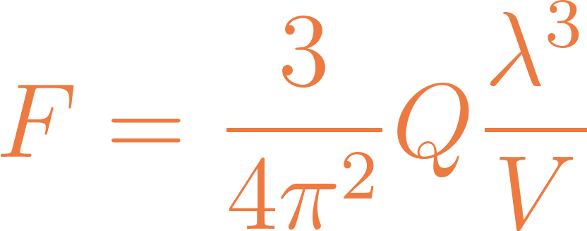
Enhancement Due to Photonic Coupling in Nanocavity Structures
Bumbia, Amal; Abudayyeh, Hamza; Liu, Zhida; Li, Xiaoqin Department of Physics, College of Natural Sciences, The University of Texas, Center for Complex Quantum Systems
Introduction
Figures and Results
Conclusion
Plasmon-exciton coupling in photonic nanostructures provides insight into quantum emitters' optical properties and how they can be manipulated via alterations to their electromagnetic environment. The interaction between this environment and any two-level system can result in the spontaneous emission of photons from the emitter. Our goal is to shorten the lifetime of exciton emission via plasmonic nanostructures. Such an alteration depends on the interplay between a photonic cavity focusing the emission fields into a mode volume, and the system. Photon emissions into the cavity are enhanced before their release into free space, the consequence is the potential to enhance previously weak fields and learn more about the material possessing the relevant nanostructure — in our case, TMD layers with nanocubes.
A reason why nanocubes enable photonic enhancement is because the electromagnetic field is more intense at the corners of the cube - the lightning-rod effect. Nanocube size and film-cube separation impact where plasmonic resonances occur.
The excitons of the emitter and plasmons of the nanocubes couple in a plasmonic cavity which focuses the emission fields into a mode volume.
PL spectra of WS₂ monolayer
Research Goal
Overlap between the plasmonic resonances and exciton excitation
provides evidence for the coupling as it facilitates enhancement. Longer wavelengths are enhanced, and there is greater, non-uniform intensity enhancement along the nanocubes. Differently sized cubes enhance different parts of exciton spectrum. We see that the enhanced resonances have the same polarizations and spectral resonances as the plasmonic resonances.
What are the effects of weak coupling between plasmonic nanocavities and excitons? How does plasmon-exciton coupling effect emission enhancement? We aim to examine different TMD samples for the effects of weak coupling between plasmonic nanocavities and excitons.
The mode volume impacts the probability of the field interacting with the emitter. A higher probability in this regard increases the probability of spontaneous emission and decreases the lifetime. The photons emit from the cavity and into free space, enhanced due to the weak coupling mechanism.
Hyperspectral spatial images of the samples with nanocubes of interest highlighted.
Methods
Acknowledgments
figures
Special thanks to Dr. Hamzah Abudayyeh and Dr. Xiaoqin Li. This work was supported by NSF grant 2130552.
Nanocubes are plasmonic resonance structures - here, we want to use them to shorten the lifetime of exciton emission . We determine the existence of nanocubes on the sample via the AFM.
Cam Nhung Vu. Antennes Gap Plasmon:Une Source de Plasmon Polariton de Surface. Université Claude Bernard Lyon 1, 2022.
H. Abudayyeh, B. Lubotzky, and R. Rapaport, “Single Photon Devices,” in 21st Century Nanoscience ch. 7, Boca
Raton: CRC Press, 1st ed., 2020
The photon is released by an excited emitter due to spontaneous emission and lost to far-field radiation modes leaving the cavity in a vacuum state. The cavity becomes the system's environment, resulting in a modified decay rate
with the Purcell factor .
References
Dark-Field scattering image of the sample displaying the positions of the nanocubes in relation to the underlying structure. The area marked with a red outline Is the monolayer region.
Notes:
$$Q \approx \frac{1}{\kappa}$$ (cavity quality factor), and the cavity mode volume $$\frac{V}{\lambda ^3}$$.
We are concerned with the weak coupling regime. The advantage of the weak coupling regime is that for emitted photons, the probability that they will be reabsorbed by the emitter is low compared to the likelihood of the photon escaping the cavity.

